Slide 1
Branching

Slide 2
Flags
Overflow Flag
Addition: CarryInMSB XOR CarryOutOfMSB
Subtraction: BorrowInMSB XOR BorrowOutOfMSB
Sign Flag
MSB of result of last Arithmetic/Logical Operation
Zero Flag
ZF=1 if all n-bits of result of last arithmetic/logical operation are zero
Carry Flag
CF=1 if
Addition MSB produced carry that does not fit in n-bit result i.e. (n+1)th bit
Subtraction: MSB took borrow

Slide 3
CMP Instruction
CMP DEST, SRC
CMP AX, BX vs SUB AX, BX ; AX = AX-BX
Flags affected by both instructions:
0F, SF, ZF, CF
CMP DEST, SRC
JB Label

Slide 4
Comparison and Conditions
Conditions | Flags | Description
DEST = SRC | ZF = 1
2 – 2 = 0 | 0F=0 SF=0 ZF=1 CF=0
-3 - -3 = 0 | 0F=0 SF=0 ZF=1 CF=0
UDEST < USRC | CF = 1 | borrow is needed which sets the carry flag.
2 – 4 = -2 2 - 80 | 0F=0 SF=1 ZF=0 CF=1 0F=1 SF=1 ZF=0 CF=1
UDEST ≤ USRC | ZF = 1 OR CF = 1
UDEST > USRC | ZF = 0 AND CF = 0
82 – 40 = 42 | 0F=1 SF=0 ZF=0 CF=0
UDEST ≥ USRC | CF = 0
See Chapter 3 of Bilal Hashmi’s Lecture Notes

Slide 5
Comparison and Conditions
Conditions | Flags | Description
SDEST < SSRC | SF ≠ OF | The answer is negative with no overflow than the destination is smaller.
-4 - -3 = -1 | 0F=0 SF=1 ZF=0 CF=1
-3 - +4 = -7 | 0F=0 SF=1 ZF=0 CF=0
+3 - +4 = -1 | 0F=0 SF=1 ZF=0 CF=1
SDEST ≤ SSRC | ZF = 1 OR SF ≠ OF
SDEST > SSRC | ZF = 0 AND SF = OF | If the zero flag is not set, it means that the signed operands are not equal and if the sign and overflow match in addition to this it means that the destination is Greater.
-3 - -4 = +1 | 0F=0 SF=0 ZF=0 CF=0
+3 - -4 = +7 | 0F=0 SF=0 ZF=0 CF=1
+4 - +3 = +1 | 0F=0 SF=0 ZF=0 CF=0
SDEST ≥ SSRC | SF = OF

Slide 6
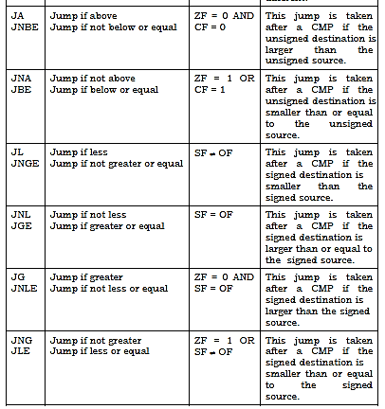
Conditional Jumps
Check list of jump instructions from Bilal
Hashmi’s Lecture Notes
Notes:
Textbook Page 33

